Slide 1
Myoelectricity uses in controlling prosthesis.
Mini project
Salman Al-Samiri, E&S4, student id:2391105
21/02/2018

Slide 2
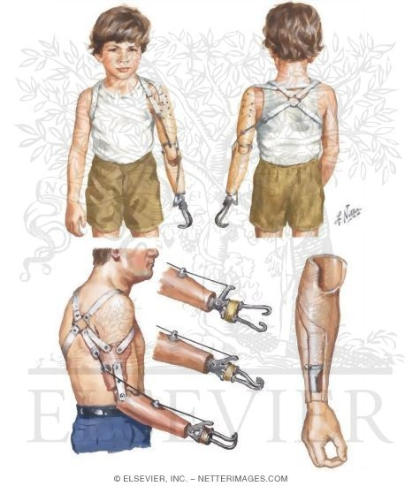
What my presentation is about?
What is myoelectricity
How myoelectrical prosthetics work differently from non-myoelectrical parts
What is built within the artificial body parts
The future uses of prosthetics

Slide 3
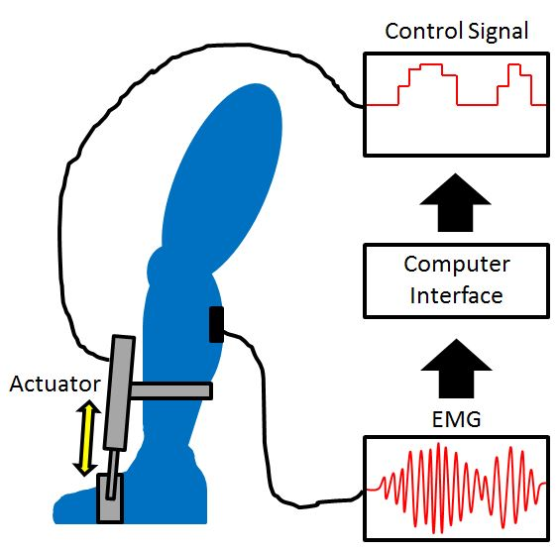
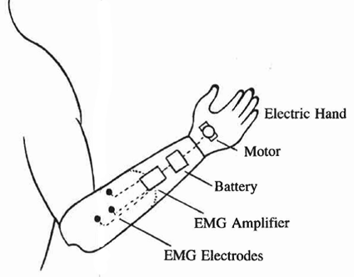
Myoelectrical prosthesis
A surgical technique called targeted muscle reinnervation (TMR) transfers residual arm nerves to alternative muscle sites. After reinnervation, these target muscles produce electromyogram (EMG) signals on the surface of the skin that can be measured and used to control prosthetic arms.

Slide 4
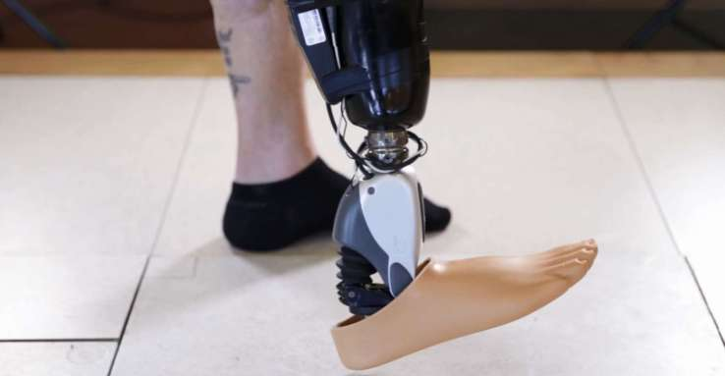
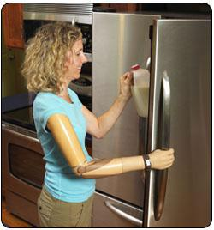
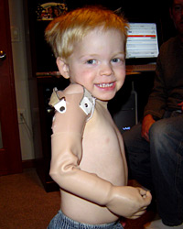
modern prosthetic
Older robotic design prosthetics arms could not be attached to the body
functional grips that confer far wider application of the replacements than previously achievable.
the goal of TMR surgery is to create new surface electromyogram (EMG) signals that can be used to control a motorized prosthetic arm.

Slide 5
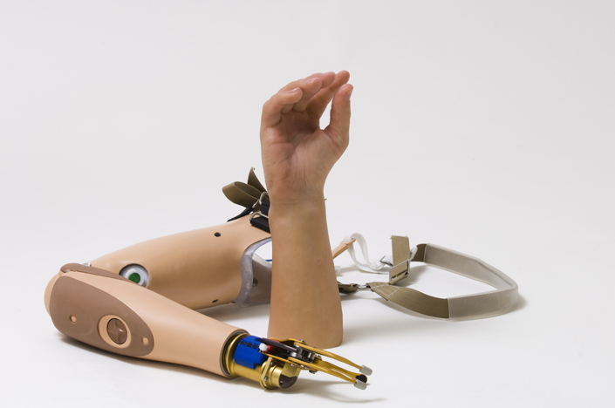
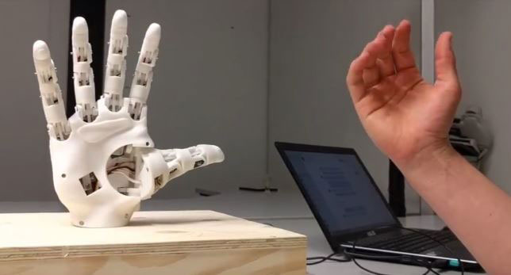
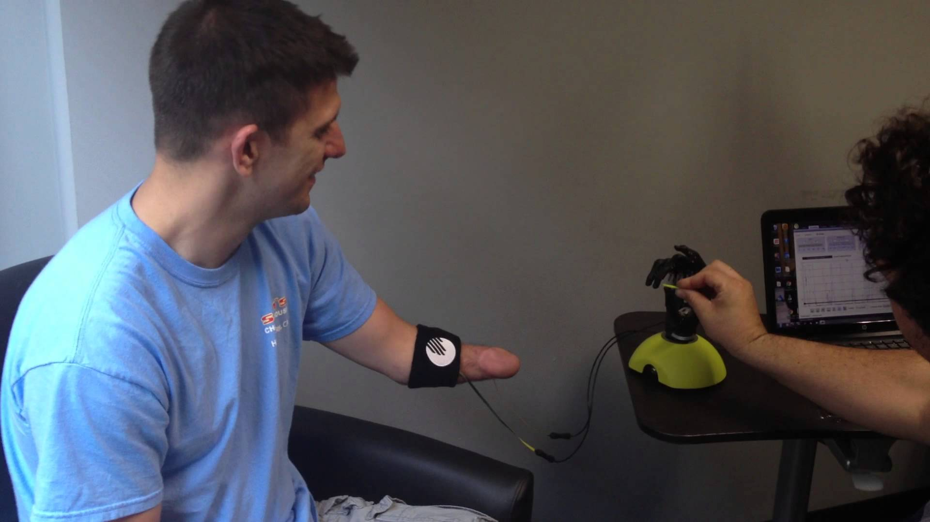
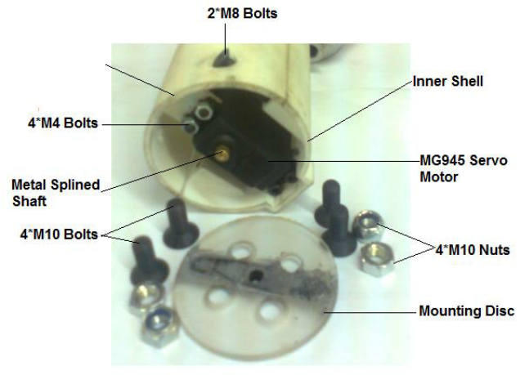
Bionic prosthetic built-in

Slide 6
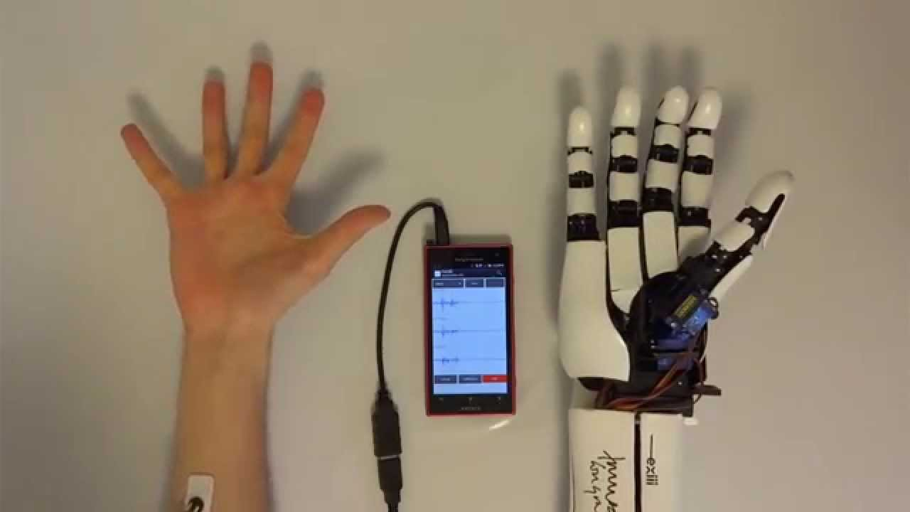
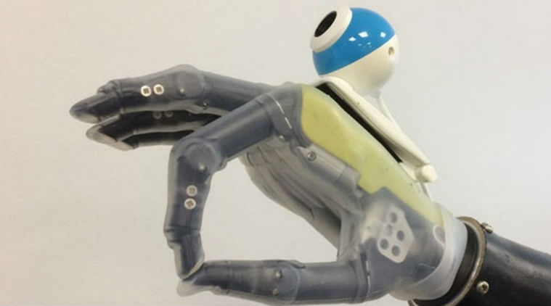
Current developments

Slide 7
Bibliography
Clement, R.G.E., Bugler, K.E. and Oliver, C.W., 2011. Bionic prosthetic hands: A review of present technology and future aspirations. The surgeon, 9(6), pp.336-340.
Kuiken, T.A., Li, G., Lock, B.A., Lipschutz, R.D., Miller, L.A., Stubblefield, K.A. and Englehart, K.B., 2009. Targeted muscle reinnervation for real-time myoelectric control of multifunction artificial arms. Jama, 301(6), pp.619-628.

